Slide 1
Noun-Verb Ambiguity In Natural Language
Cs19mds11001 – Ravi Bhushan Singh
Cs19mds11015 – Anupama
Cs19mds11023 – Prashant Singh

Slide 2
OUTLINE
Problem Statement
Approach
Stepwise Data Preparation-1
Stepwise Data Preparation-2
Model Description
BiLSTM Model Architecture
Model Evaluation
References
Thank You!

Slide 3

Problem statement
To solve for noun-verb ambiguity on given dataset.

Slide 4

Approach:
In our attempt to solve Noun-Verb ambiguity we followed following steps:
Transform dataset – We transformed dataset so that we have 3 tags.
‘NN’ – Tokens which were tagged as NN (Noun).
‘Verb’ – Tokens which were tagged as Verb
‘None’ – All other tokens like DT, PS, ADJ etc..
2. Use a pretrained embedding
3. Retrain embedding to incorporated contextual informal using BiLSTM network
4. Train Sequence-to-Sequence Bidirectional LSTM model on transformed dataset.
We will discuss each steps in detail in upcoming slides.

Slide 5
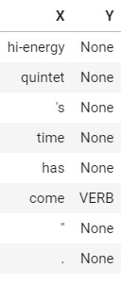
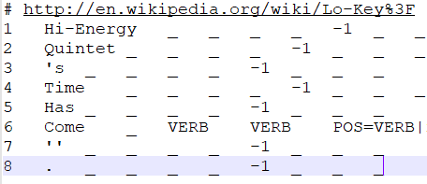
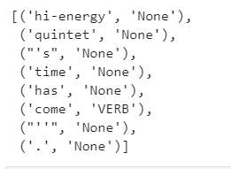
Step-wise Data Preprocessing-1
Raw Conll data
Convert data to machine readable format. Update Y labels such that Y ∈ {‘Noun’, ‘Verb’, ‘None’}
Separate X and Y-Labels

Slide 6
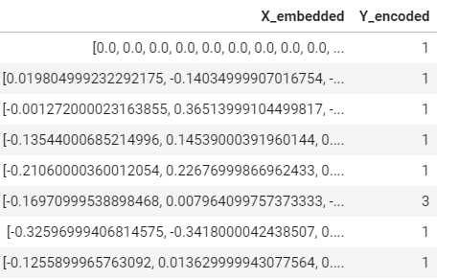
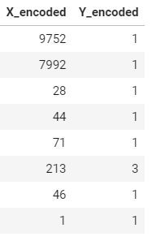
Step-wise Data Preprocessing-2
Separate X and Y-Labels
Convert words to corresponding tokens.
We replaced each word with its corresponding GLOVE embedding. We will retrain these embeddings in BiLSTM model to incorporate contextual information

Slide 7
Model Description:
1. We posed given problem statement as Many-To-Many Sequence modelling where input is word embeddings and output is tag of word (as described in previous slide.)
2. Used bidirectional LSTM, which propagates signal backward as well as forward in time.
3. Gradients were allowed to go through embeddings too so that we can incorporate contextual information of sentences in embeddings, which is otherwise non-contextual.

Slide 8

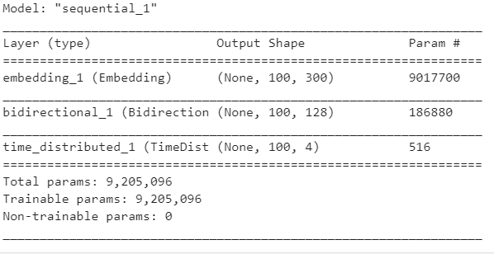
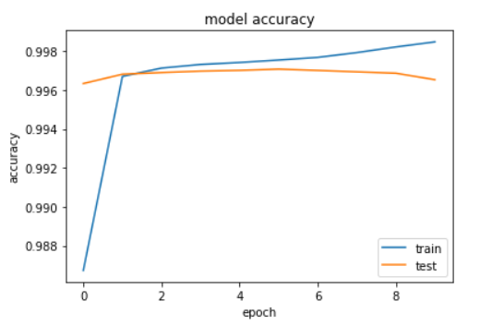
BiLSTM Model Architecture

Slide 9
Model Evaluation
Training Accuracy | Validation Accuracy | Held-out dataset Accuracy
99.85% | 99.65% | 98.71%

Slide 10
References
Dataset Used- https://github.com/google-research-datasets/noun-verb
Reference Paper-
https://www.aclweb.org/anthology/D18-1277.pdf

Slide 11

Thank You!

